Slide 1
Predicting Weather Caused Train Delays Finnish Meteorological Institute

Slide 2

Target to predict disruption of rail traffic caused by weather related phenomena’s
Problem restricted strictly to weather – delays of other trains are not considered in prediction
Project
Project timeline: 01/2018-10/2018
Project partners: IL, LiVi, Trafi, VR
Area: Finland
Time range: 2 days ahead Time step: 1 hour
Notes:
Clients are about to get new online train delay forecasting system

Slide 3
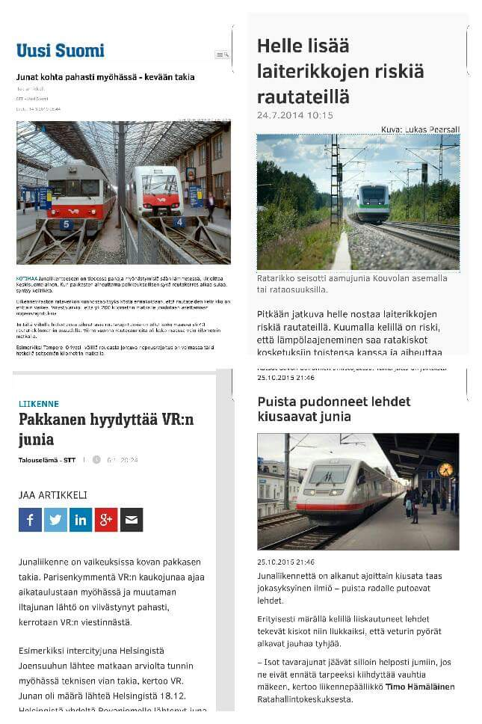
Motivation

Slide 4
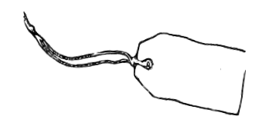
Possible labels for training
Trains delayed between stations
Trains delayed at end station of the route (minutes reported to every station to time stamp when train passed the station)
Trains delayed at whole route calculated from all stations
Trains delayed at whole route calculated from end stations
Label Data

Slide 5
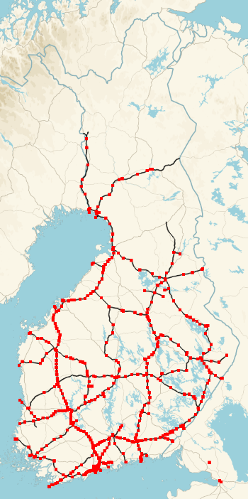
514 stations
~10 trains per hour at busiest stations
Many stations host only few trains per day
Some stations contain only cargo traffic
Label Data

Slide 6
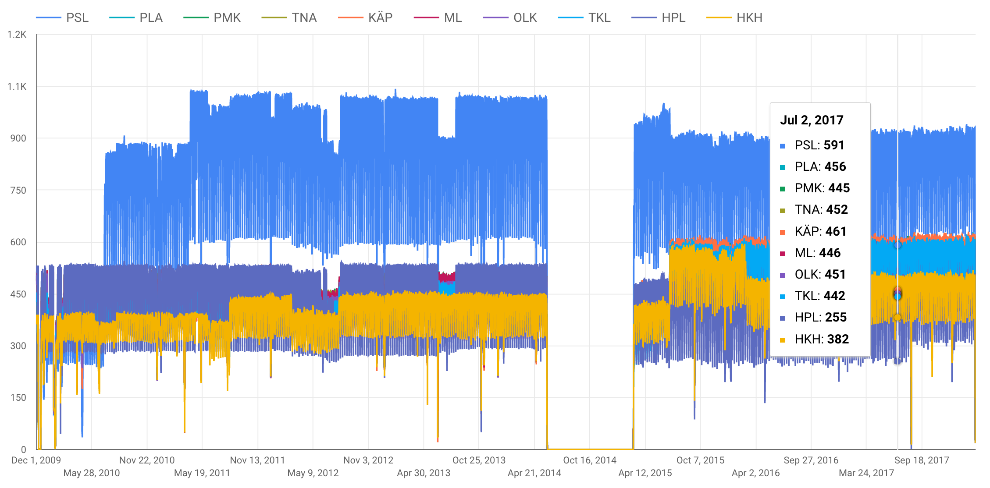
Label Data Train count per day

Slide 7
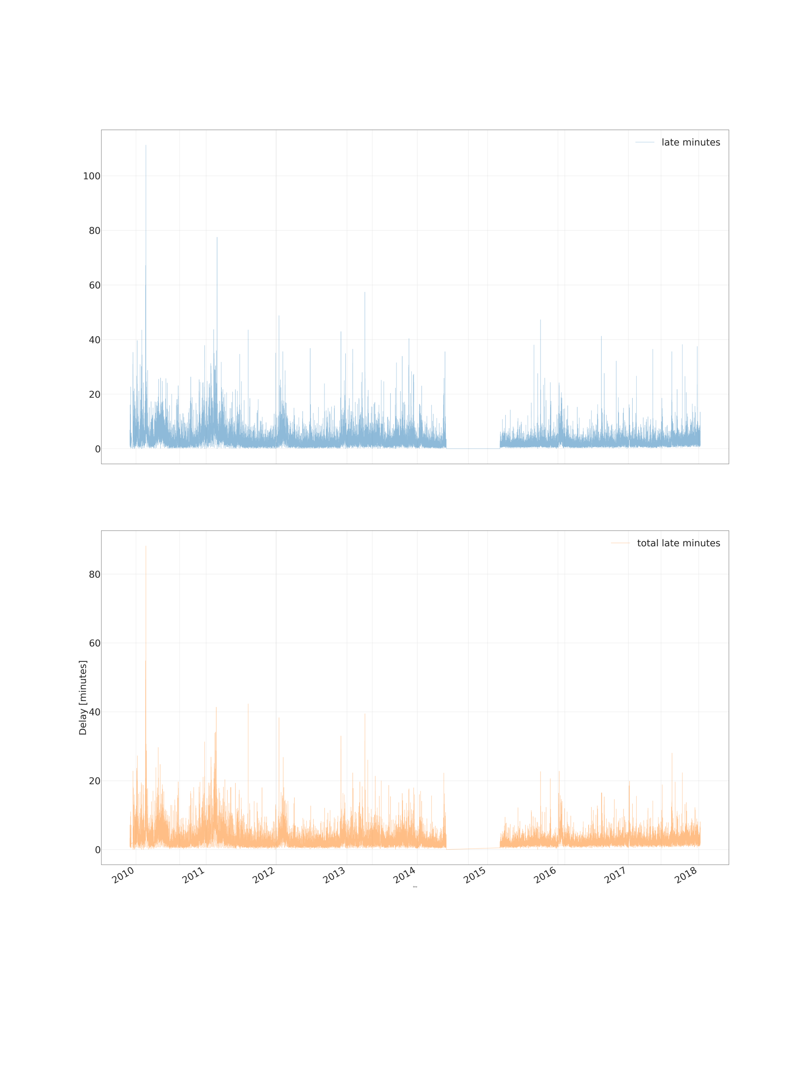
Label Data Mean delay between stations, passenger trains

Slide 8
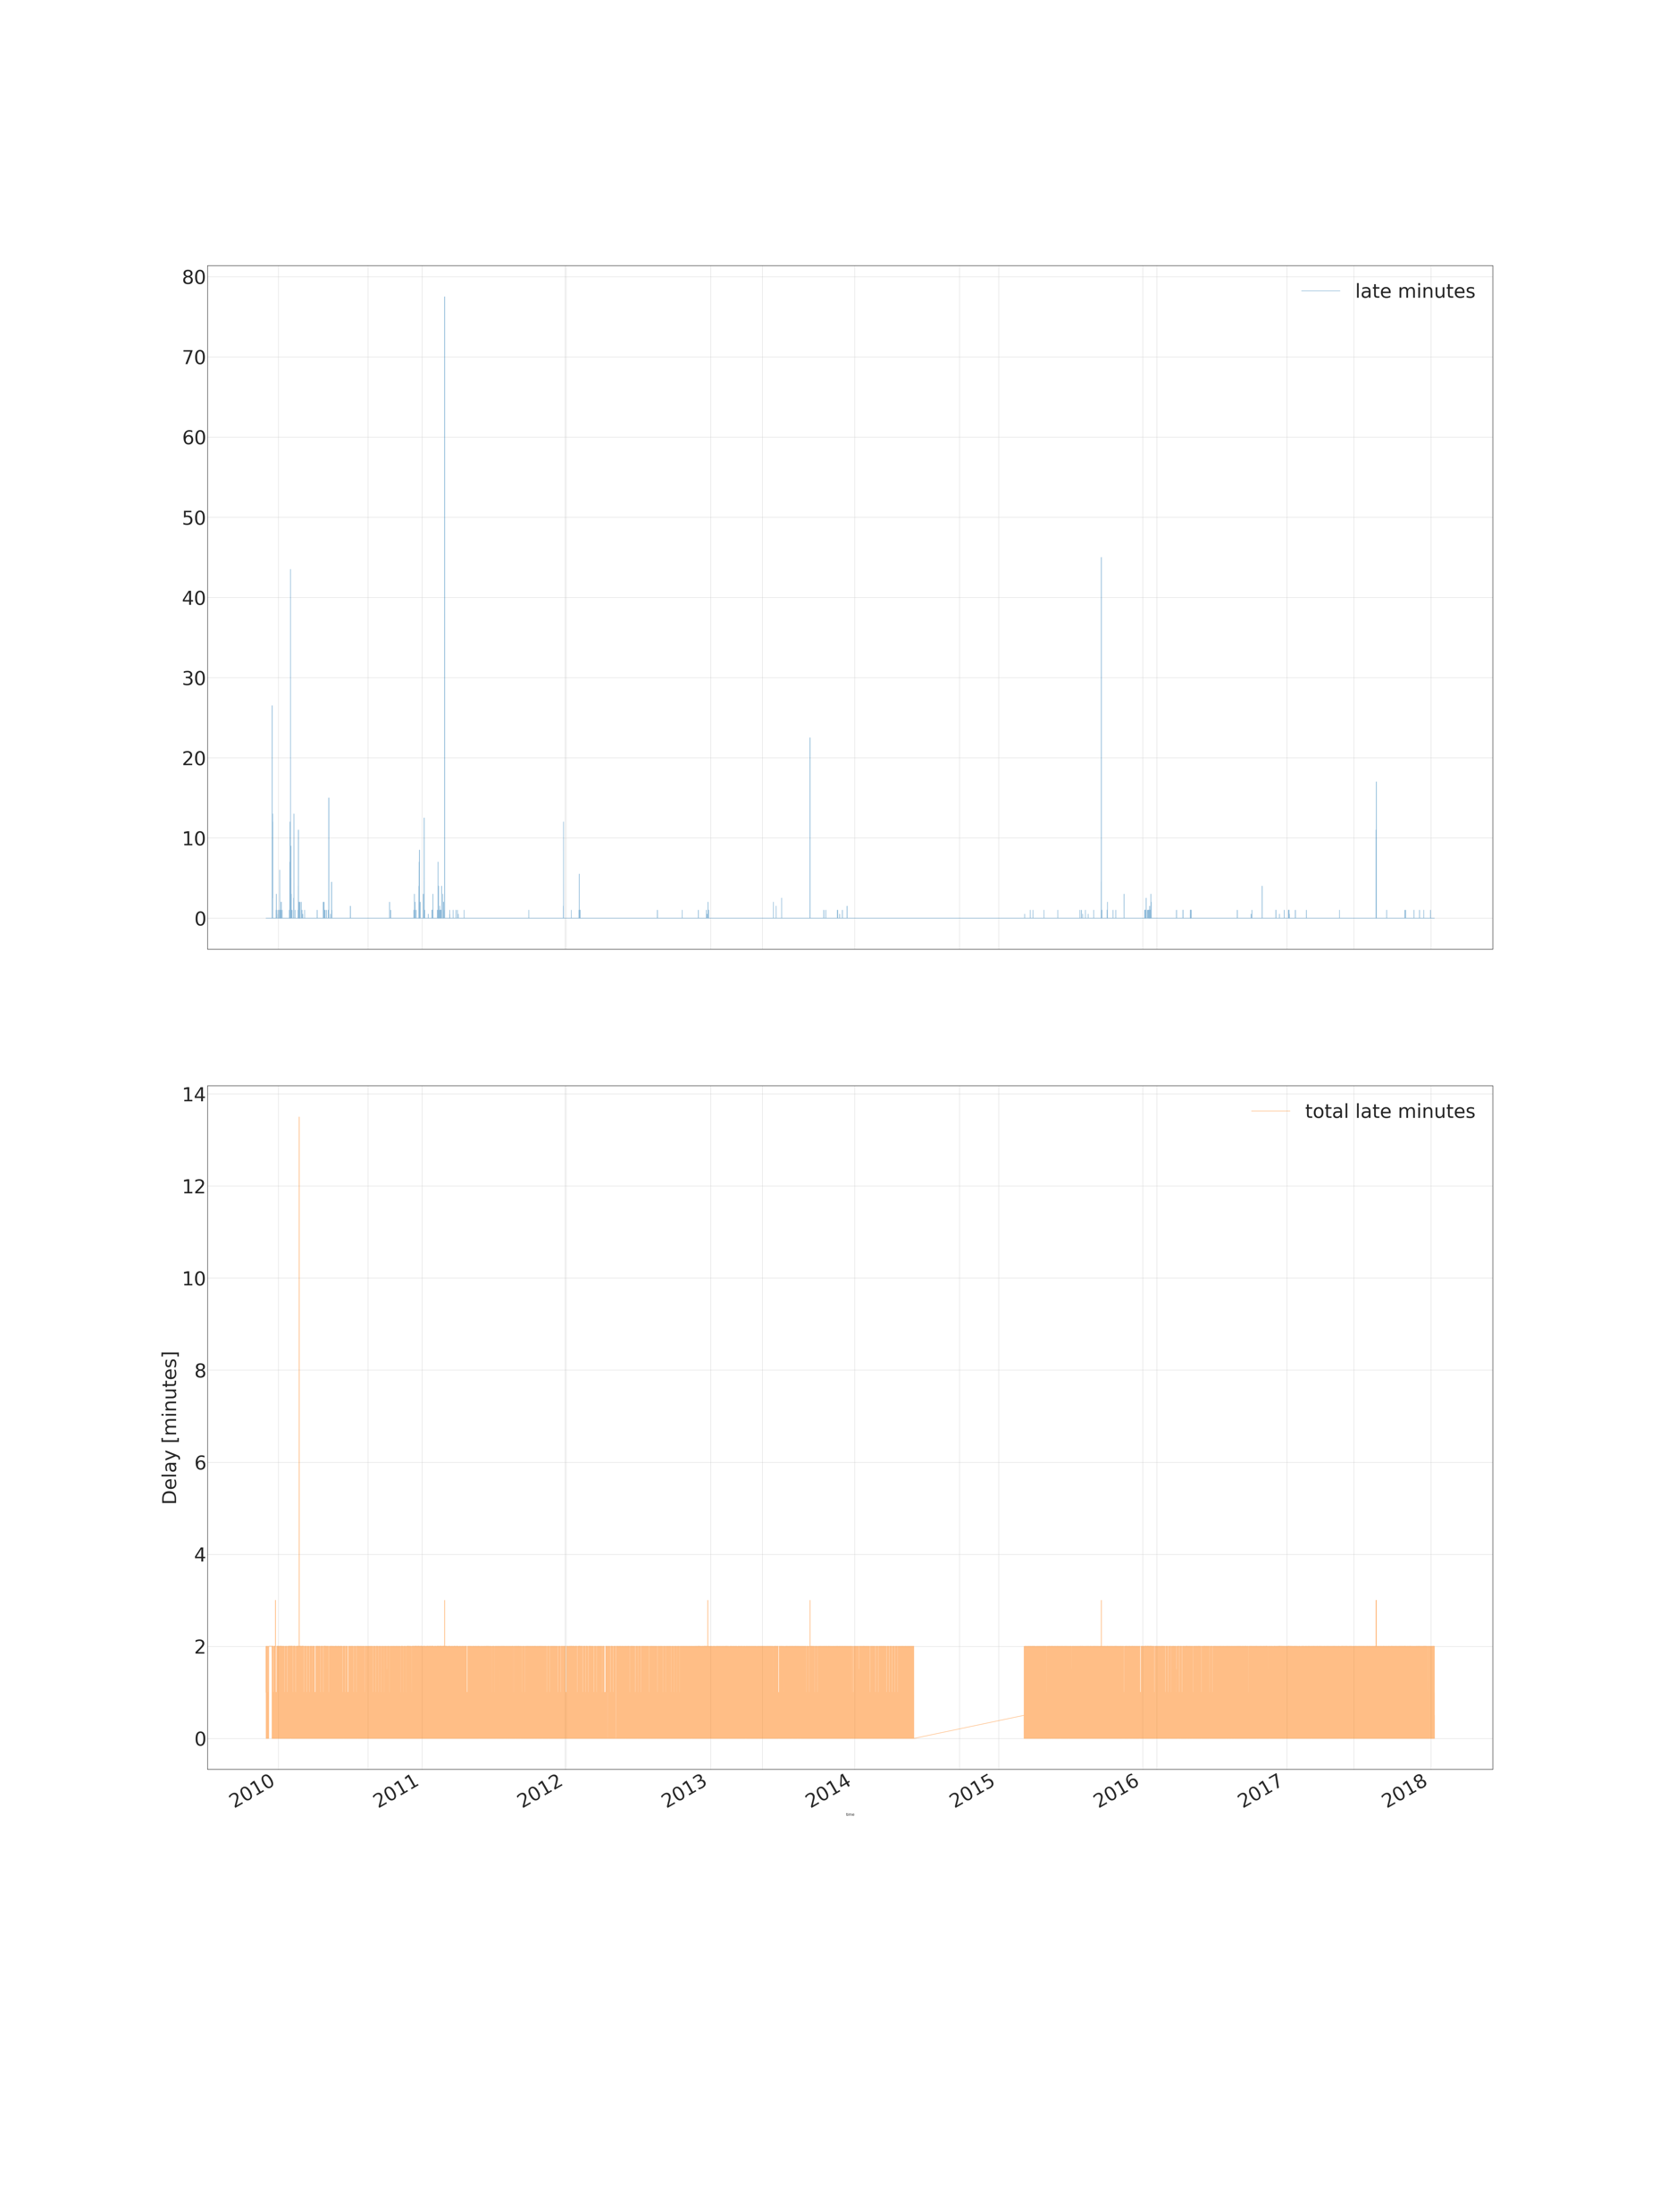
Label Data Median delay between stations, passenger trains

Slide 9
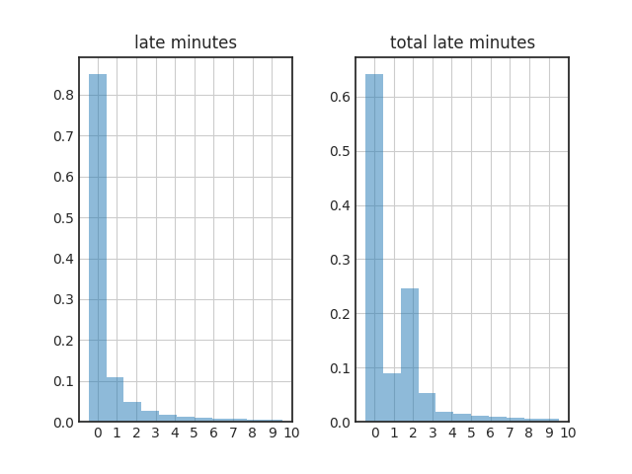
Label Data Histogram of delays, passenger trains

Slide 10

Label Data Heatmap of delays, passenger trains, 2010

Slide 11

Label Data Heatmap of delays, passenger trains, 2011

Slide 12
Label Data Correlation with weather parameters
 | a_b_late_min | temperature | pressure | dewpoint | humidity | winddirection | windspeedms | windgust
a_b_late_min | 1.0 | -0.2 | -0.1 | -0.2 | 0.1 | 0.0 | -0.2 | -0.2

Slide 13
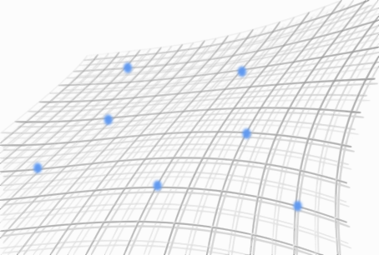
Features for training:
19 weather observation parameters near train stations
Four train types (intercity, commuter, cargo, other)
We consider only passenger trains
Training with data from 2010 to 2018
Dataset size 27 132 093 rows
Features for prediction
The same weather parameters as in training fetched from Harmonie numerical weather prediction model
Feature Data

Slide 14
Data pre-processing
Weather observation fetched for every train station for every hour when train has passed the station
Observations fetched with 100 km radius from train station using aggregation functions (min/max/mean/count) to minimize amount of missing values
Calculated 3h and 6h precipitation accumulation sums
Tried with and without imputation and normalisation
Tried also PCA, ICA and K-Means clustering

Slide 15
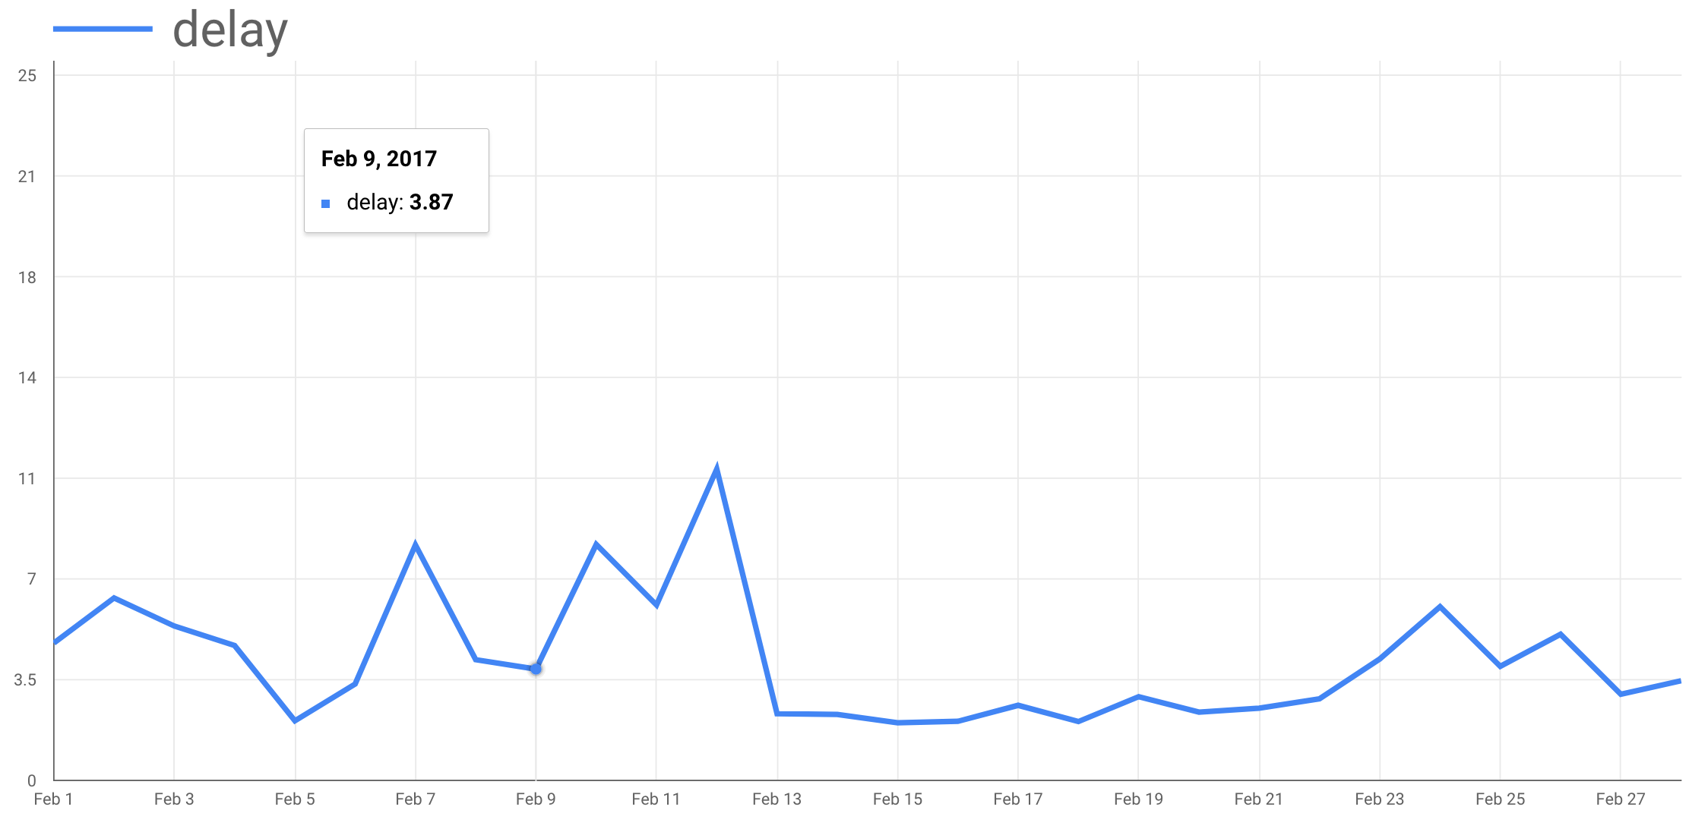
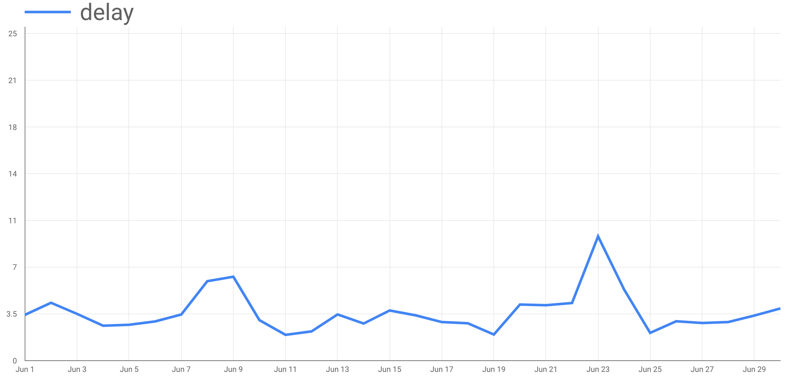
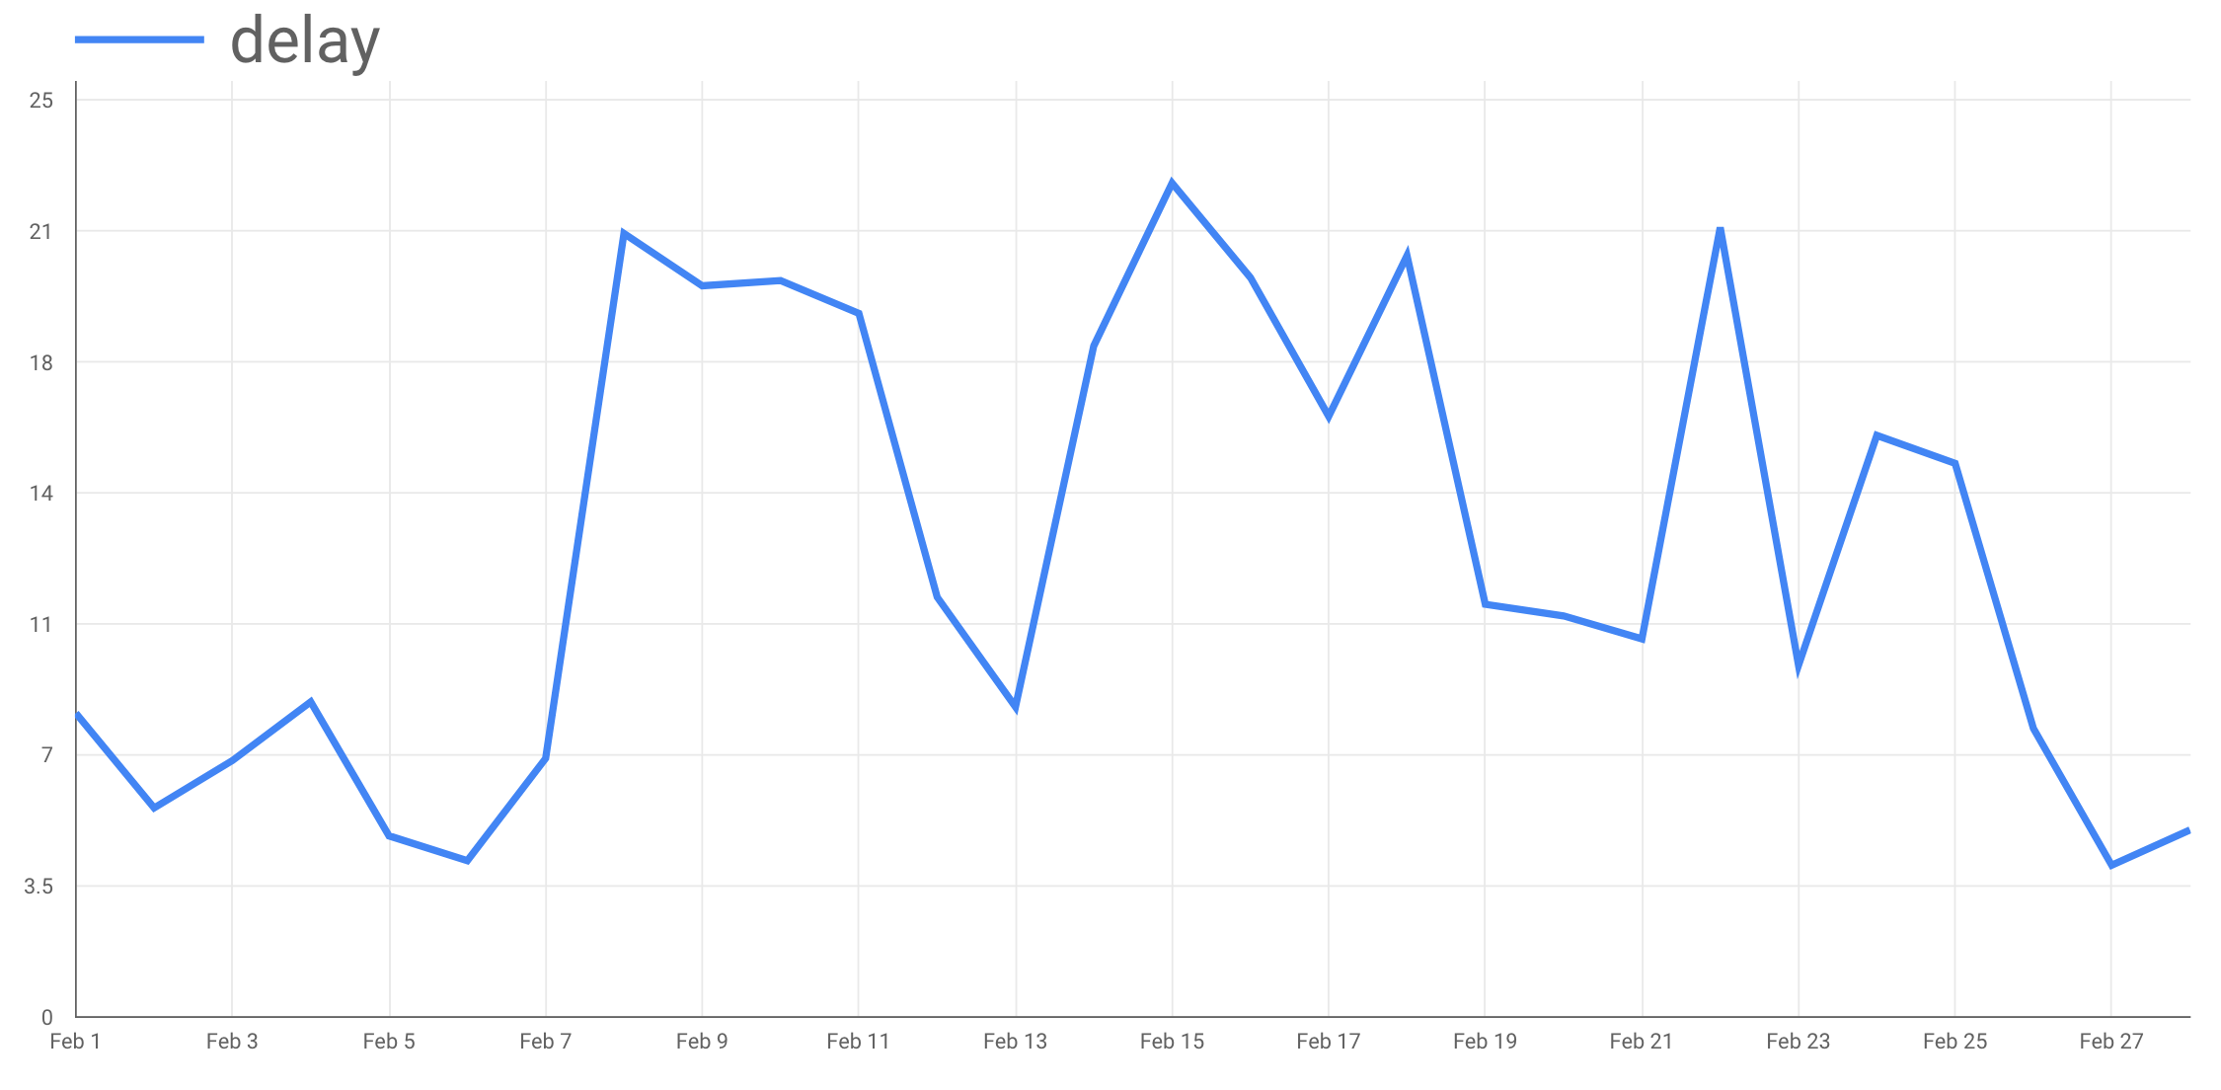
Train, validation and test data
02/2017
06/2016
Separated three selected months for testing model performance
Rest of the dataset splitted randomly to train and validation dataset with ratio 70/30 %
02/2011

Slide 16
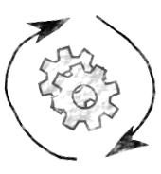
Method
Few different ML methods considered
LR / RFR / LSTM / other?
Random search used for finding optimal hyper parameters of LR and RFR
LSTM neural network currently under research

Slide 17
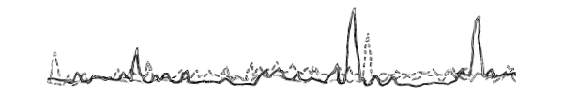
Results Best results so far
Best RFR
RMSE: 13.55
MAE: 4.52
Best LR
RMSE: NaN
MAE: NaN
Best LSTM
RMSE: 11.38
MAE: 7.87
Didn’t converge

Slide 18
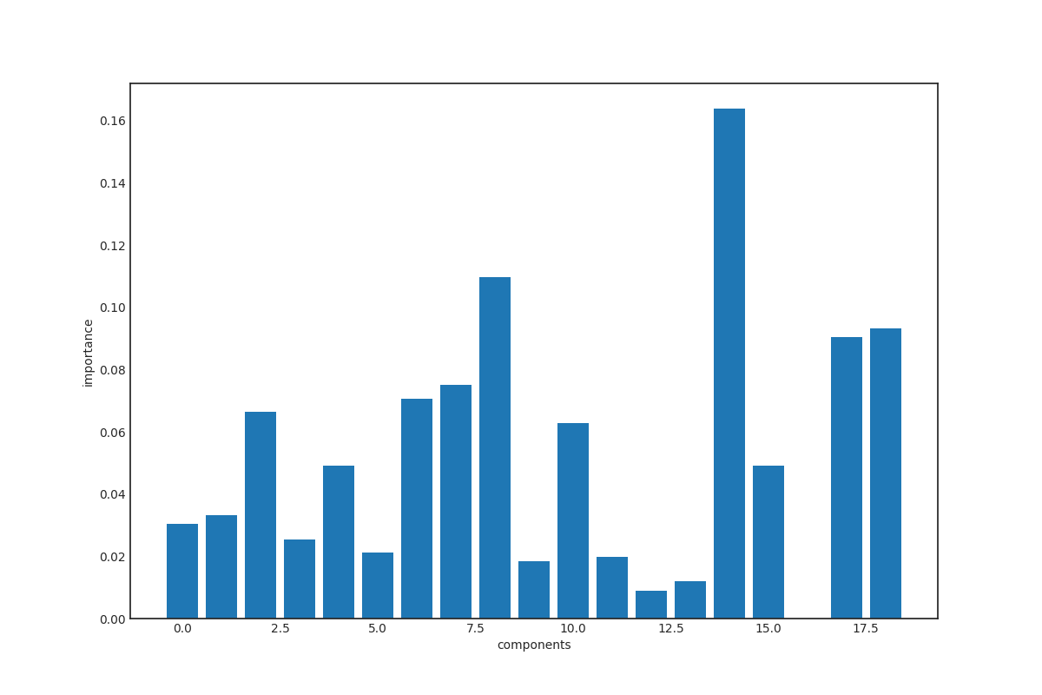
Results Feature Importance

Slide 19
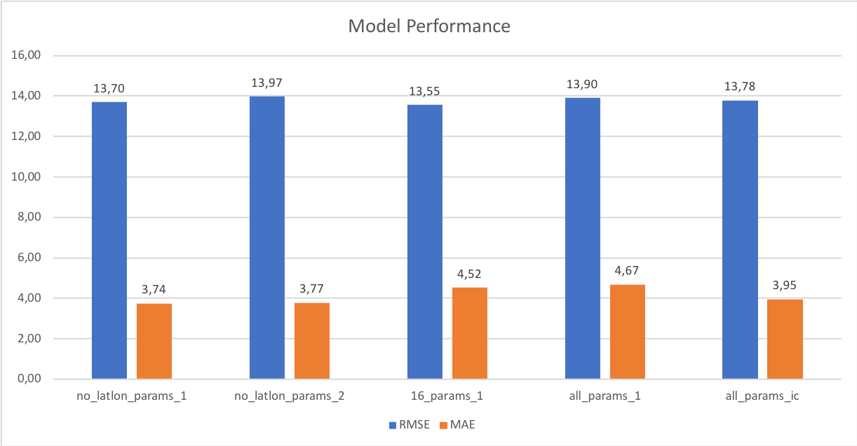
Results Different setups
Results are trade-off between MAE and RMSE
MAE tells about overall accuracy while RMSE gives more weight on large mistakes
Best RFR
RMSE: 13.55
MAE: 4.52

Slide 20
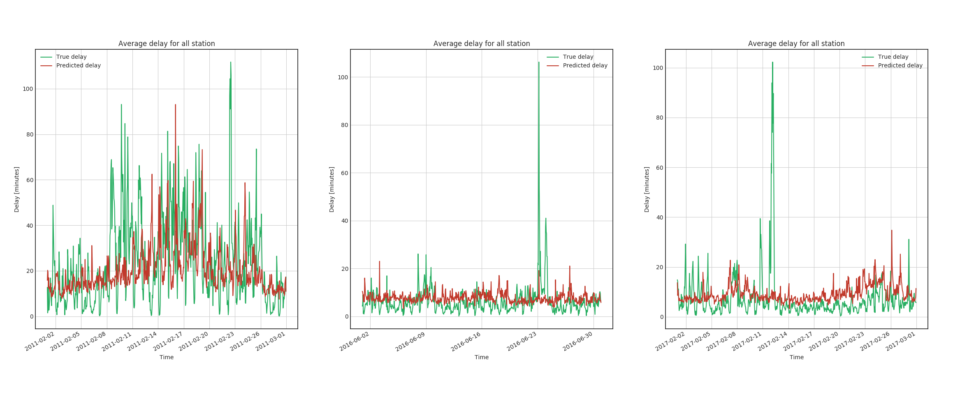
Results Best RFR
Predicted vs. true delay, average over all stations

Slide 21
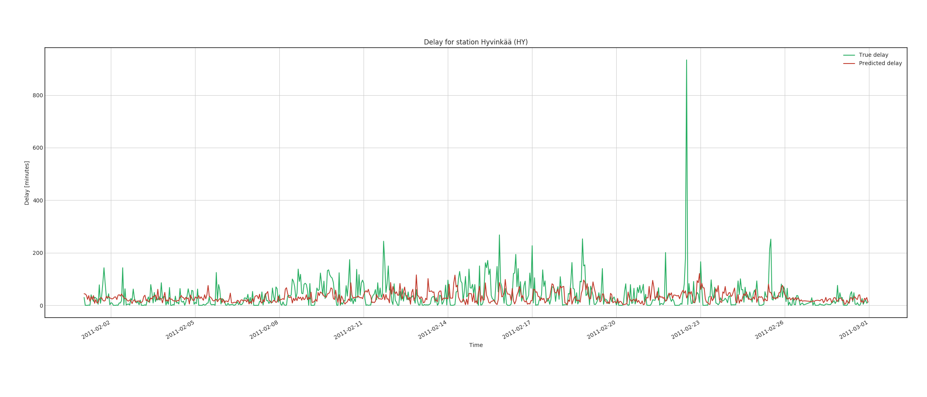
Results Best RFR
Predicted vs. true delay, good stations

Slide 22
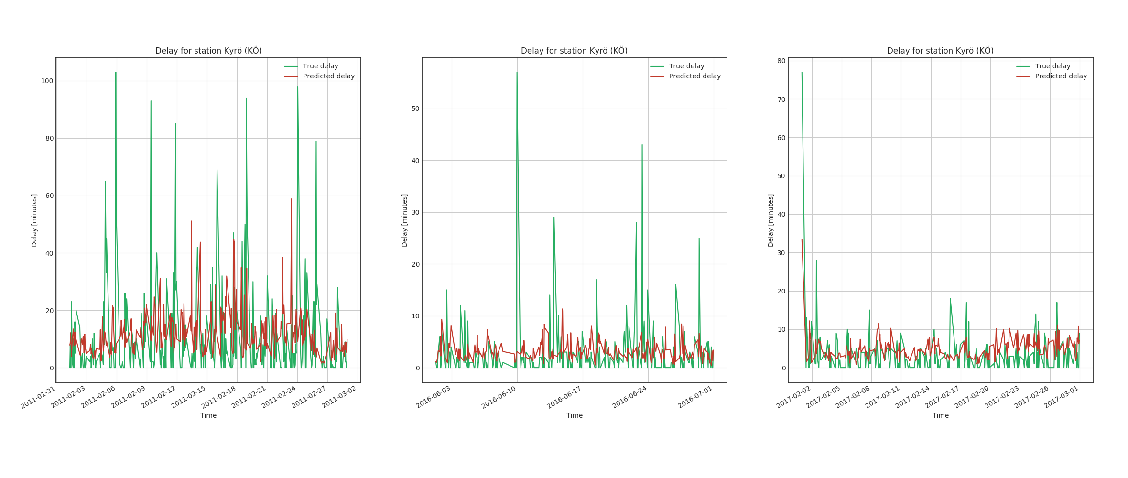
Results Best RFR
Predicted vs. true delay, good stations

Slide 23
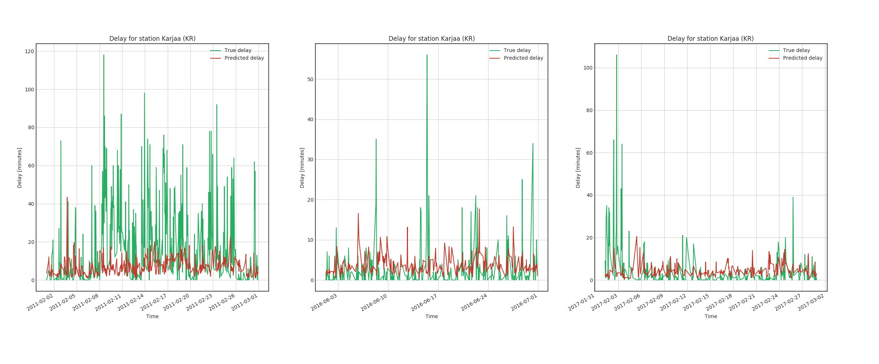
Results Best RFR
Predicted vs. true delay, bad stations

Slide 24
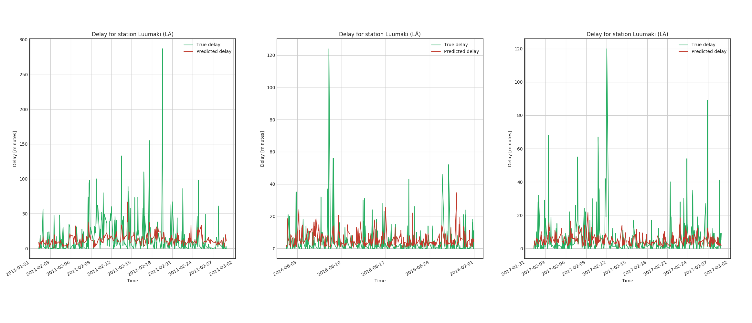
Results Best RFR
Predicted vs. true delay, bad stations

Slide 25
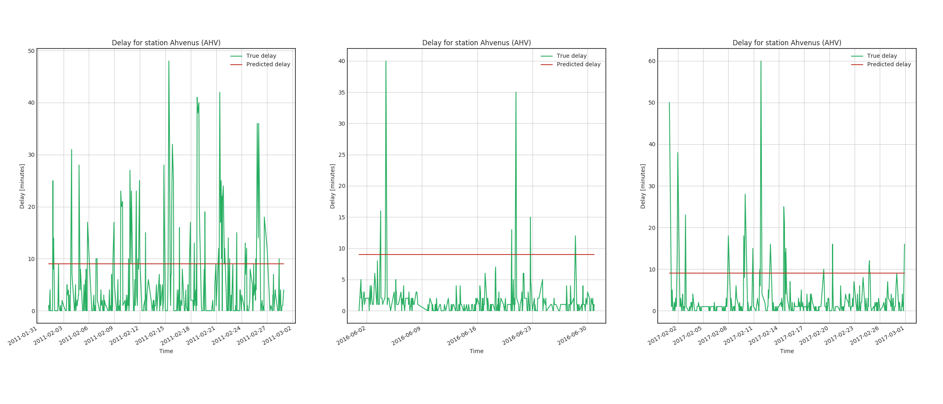
Results Best LSTM
Predicted vs. true delay, one example

Slide 26
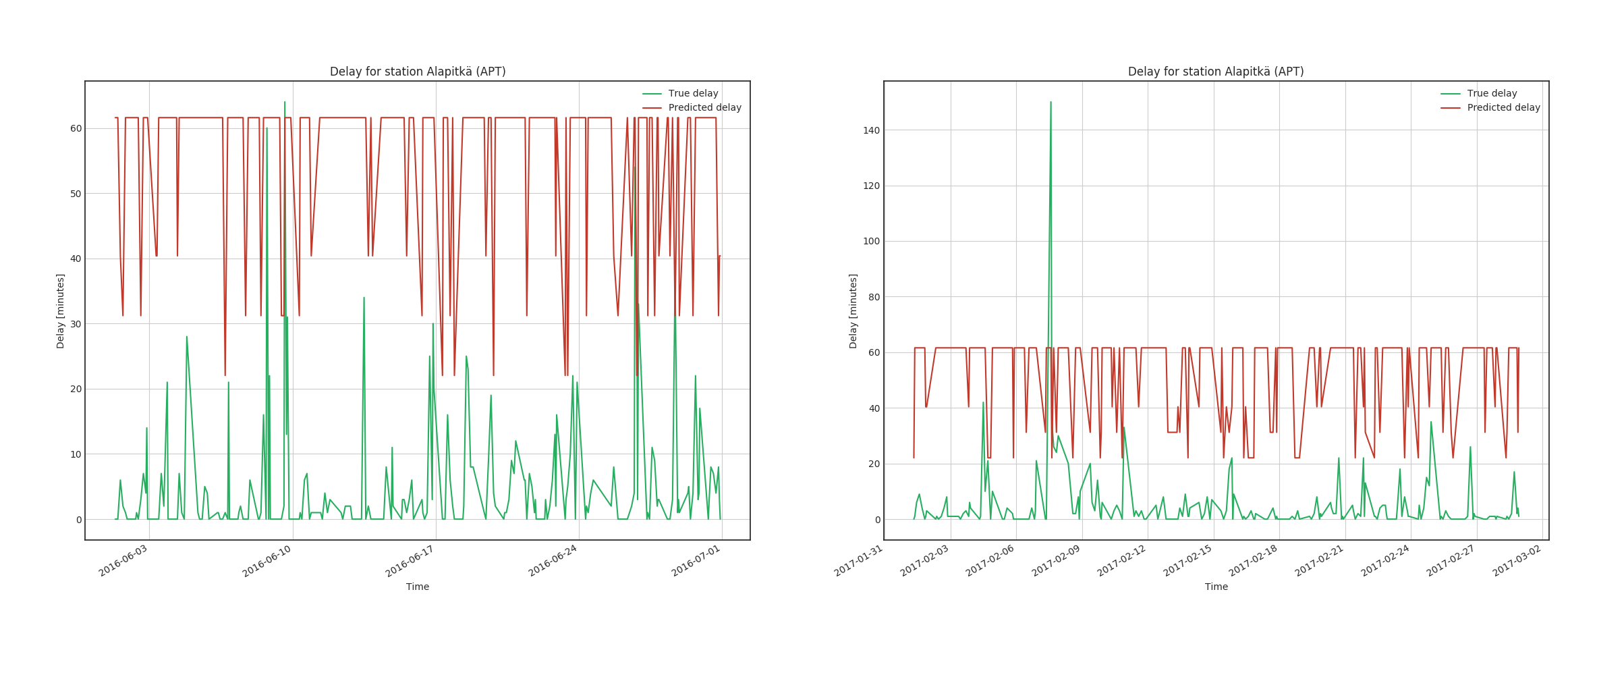
Results LSTM version 0.2
Predicted vs. true delay, next version

Slide 27
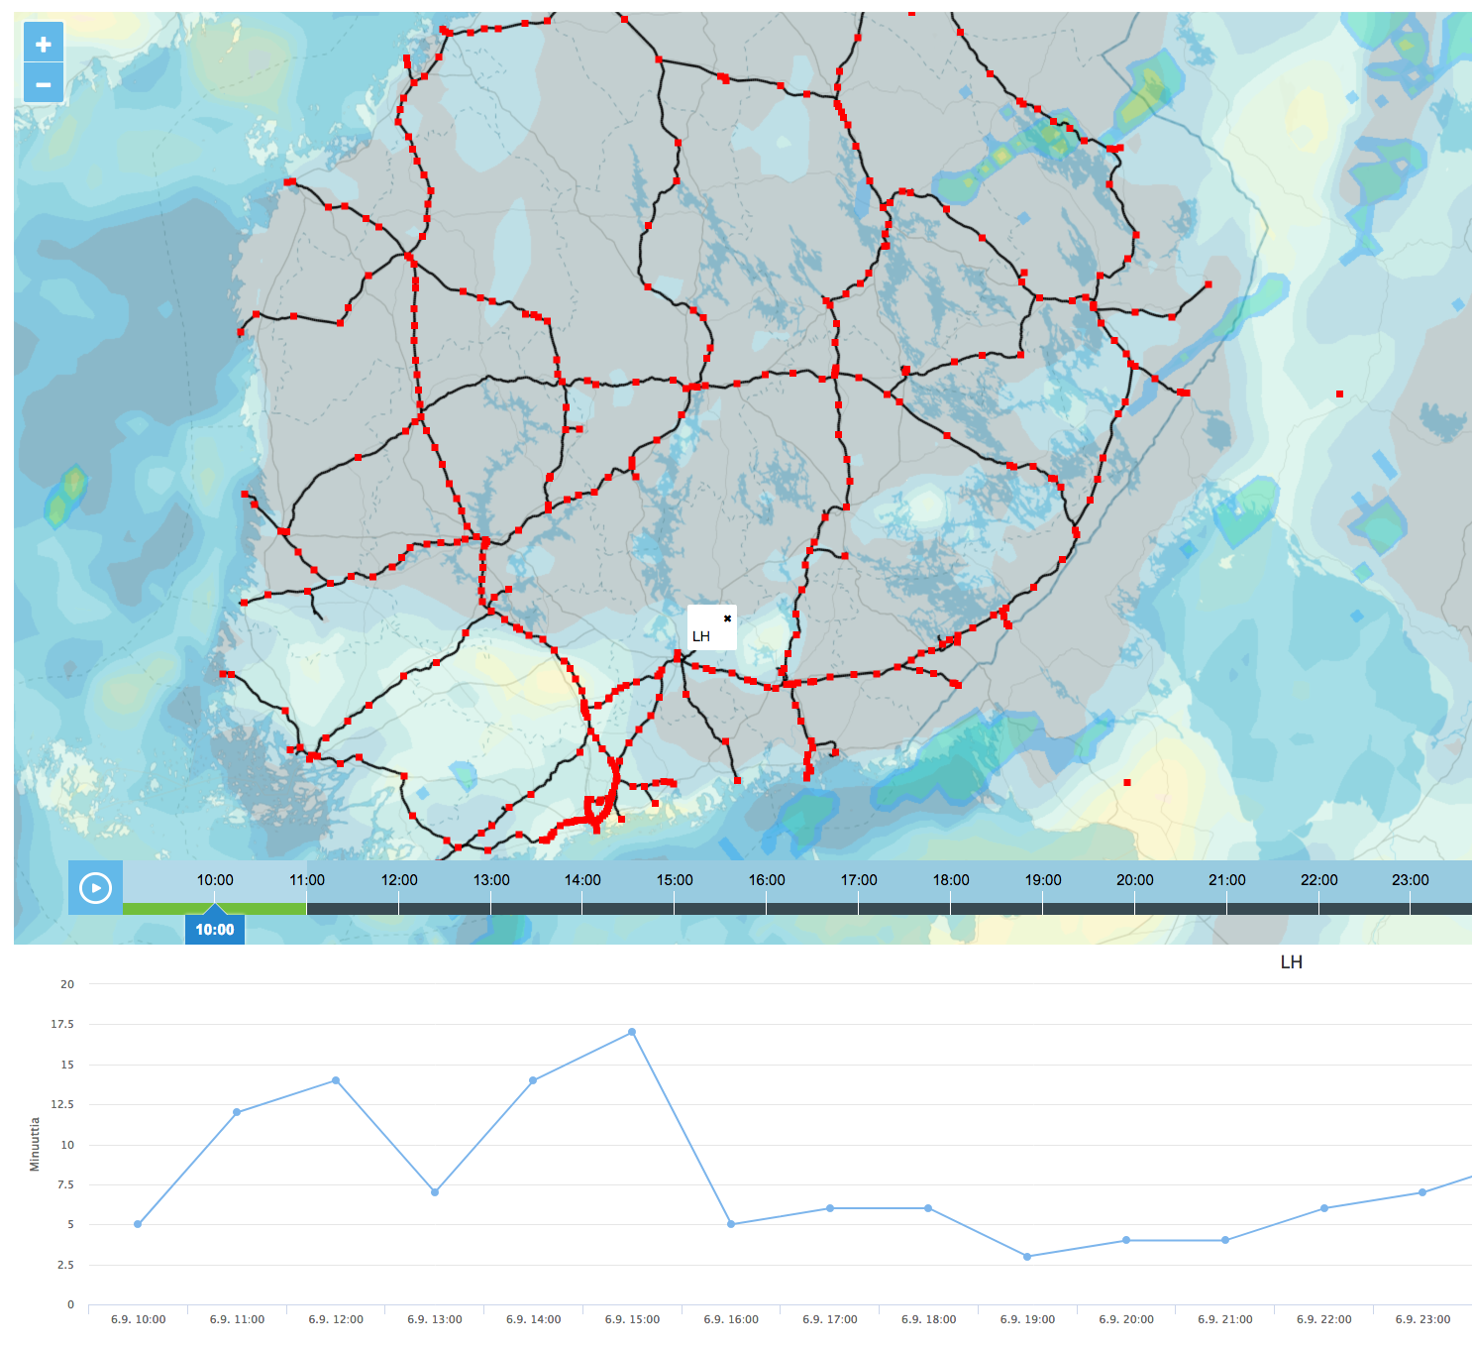
User Interface

Slide 28





Tools
Labels (train statistics) got as csv
Features (weather observations) fetched from http data server
Labels and features stored in Google Big Query
Prediction model implemented with SciKit (LR, RFR) and TensorFlow (LSTM)
Spark used for distribution
Fetching data
Possibly also for tuning LSTM

Slide 29
Delay data:
https://www.dropbox.com/s/oxpqnj2a6l1revn/gratu%202010-14.zip?dl=0
https://www.dropbox.com/s/wuogtxj31ans5fd/2015-18.zip?dl=0
Delay + feature data:
https://www.dropbox.com/sh/efuotuu1slwqb00/AAB344cobWFACiVScAkQZtWea?dl=0
Data
Notes:
Caution processes
Bayesian methods
Correlations

